Slide 1
Smartgrid
By m4st3r_h4ck3rz_4_l1f3.mp3

Slide 2
Introduction
Electricity generation is being done by a lot households nowadays
How to save this energy efficiently/economically is an complex problem
We will use heuristic methods to find our solutions

Slide 3
About our case
We look at 3 dummy neighborhoods
Every house has it’s own output of energy
Every battery has it’s own capacity to store this energy

Slide 4
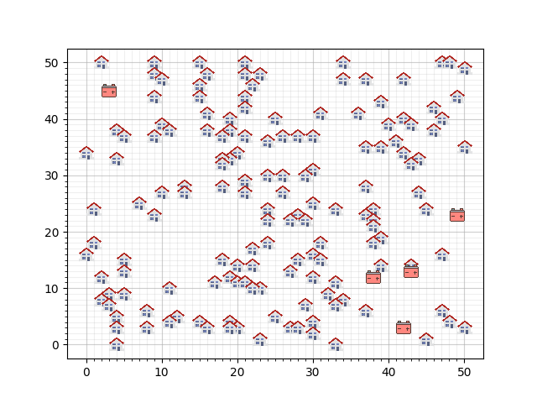
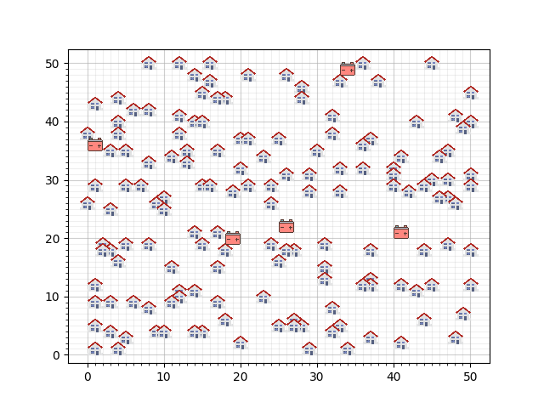
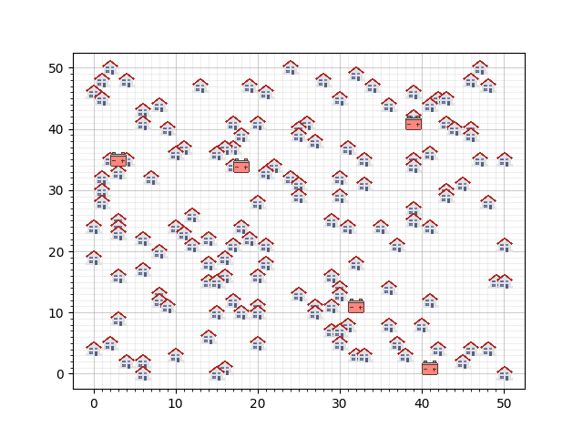
Neighborhood #1
Neighborhood #2
Neighborhood #3

Slide 5
First mission
The following constraints hold:
Batteries can’t be connected with each other, not even through a house
A house may not be connected to multiple batteries
A house has it’s unique cable to a battery, cables overlapping on the same gridline are still unique
Find a feasible solution for the 3 neighborhoods, so that all houses are connected considering the battery capacities
Here we just start with a random solution

Slide 6
Second mission
Under the same constraits as the previous mission, minimize the cost of your solution
Batteries cost 5000 each and cables cost 9 per gridline
Here a ‘greedy’ algoritme could be used

Slide 7
Third mission
The following constraints hold:
Batteries can’t be connected with each other, not even through a house
A house may not be connected to multiple batteries
A cable may be used by multiple houses
Find a feasible solution for the 3 neighborhoods, so that all houses are connected considering the battery capacities
Here we also just start with a random solution

Slide 8
Fourth mission
Minimize the cost for these new solutions of the third mission
Batteries cost 5000 each and cables cost 9 per gridline
A ‘greedy’ algoritme is also our first instinct here

Slide 9
First advanced mission
Try to optimize the solution of the fourth mission by moving the batteries around
We are awaiting results from the previous missions, before we do a guess on which heuristic method would apply well in this case

Slide 10
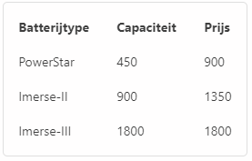
Second advanced mission
Try to find the best configuration, using this table
Use as many batteries as you want and place them anywhere, except on a house

